Slide 1

AI Applications in
Team 11
Marketing

Slide 2
Marketing
“The truth is people may see things differently, but they don’t really want to.”
― Don Draper ( Mad Men, 1960)

Slide 3

Problem Statement
How do we improve marketing strategies to achieve competitive advantage in a rapidly advancing landscape.

Slide 4
Problem Statement
01
02
03
Customer Segmentation
Purchase Pattern Analysis across different segments
Predictive Analytics
How do we segment the target audience more accurately based on their behavior?
How do we identify purchase patterns in consumer behavior based on given data?
How do we analyze historical data to forecast future trends and outcomes?

Slide 5
Problem Statement
“AI systems are good at spotting patterns when given access to the right data”
― Andrew Ng
(TedTalk: How AI could empower any business)

Slide 6

Possible AI Applications
Data collection
Data-driven analysis
Natural language processing (NLP)
Machine learning (ML)to deliver customer insights

Slide 7
Research Paper
Predictive analytics using big data for increased customer loyalty: Syriatel Telecom Company case study
Wissam Nazeer Wassouf , Ramez Alkhatib, Kamal Salloum and Shadi Balloul
-Journal of Big Data (2020)

Slide 8
Research Introduction
Background: The telecom sector is experiencing a surge in data, which can be analyzed to manage and retain customers.
Importance: Predicting customer loyalty is crucial for telecom operators to maintain and increase their market share.
Objective: The paper presents a methodology for telecom companies to target different-value customers with appropriate offers and services.

Slide 9
Methodology and Implementation
TFM Approach
Data Analysis
Evaluation:
Customers are segmented using Time-frequency-monetary (TFM) approach to define loyalty levels.
Utilizing a dataset from Syriatel corporation, classification algorithms (Multiple and binary classifiers) are applied to build predictive models for customer loyalty.
Models are evaluated based on criteria to derive loyalty prediction rules and discover loyalty reasons for targeted offers

Slide 10
Conclusion and Implications
Findings
Implications
Future Work:
The TFM segmentation and loyalty levels are effective in predicting customer loyalty in a big data environment.
The research provides insights for telecom companies to enhance customer satisfaction and retention through targeted strategies.
Further research is suggested to refine the models and explore their applicability in different market segments.

Slide 11

Technical Coding Demo
Dataset: Marketing_campaign.csv
Source: https://www.kaggle.com/datasets/whenamancodes/customer-personality-analysis
Colab: https://colab.research.google.com/drive/1lVZ0KlW8y3Sjoj5toVHkgBxVHYnNZY0o#scrollTo=a5ed6431

Slide 12
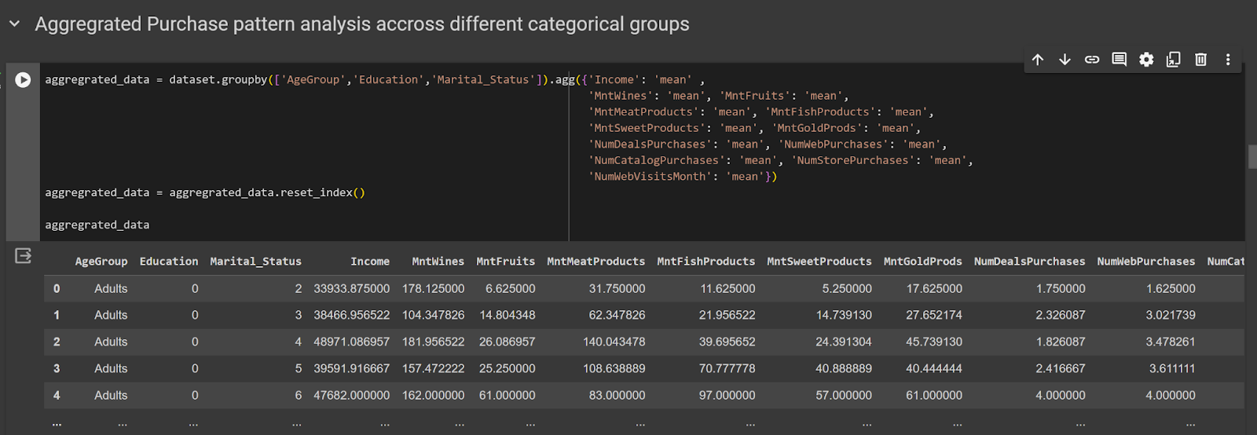
Technical Coding Demo

Slide 13
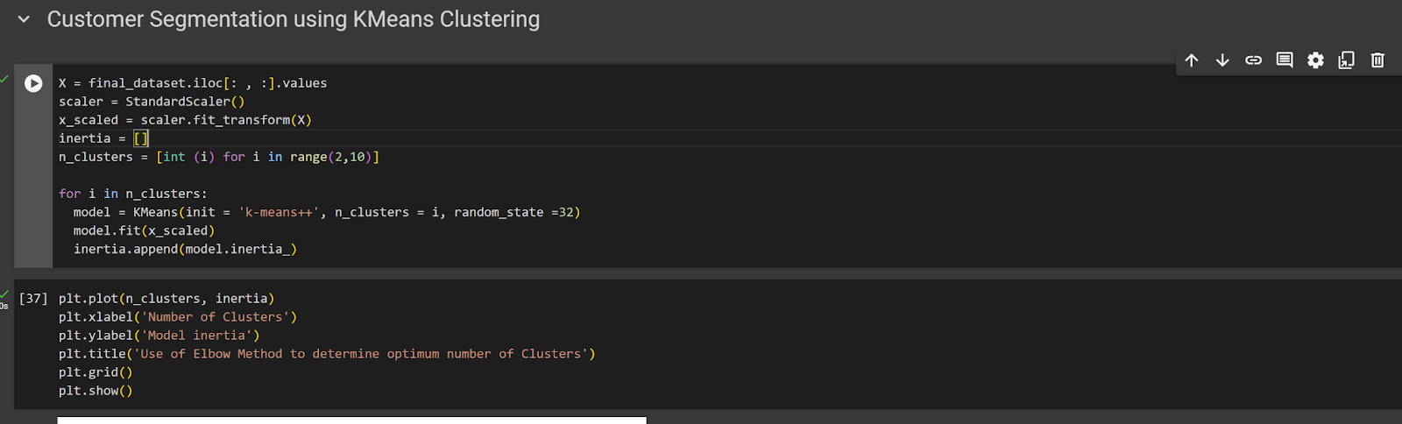
Technical Coding Demo

Slide 14
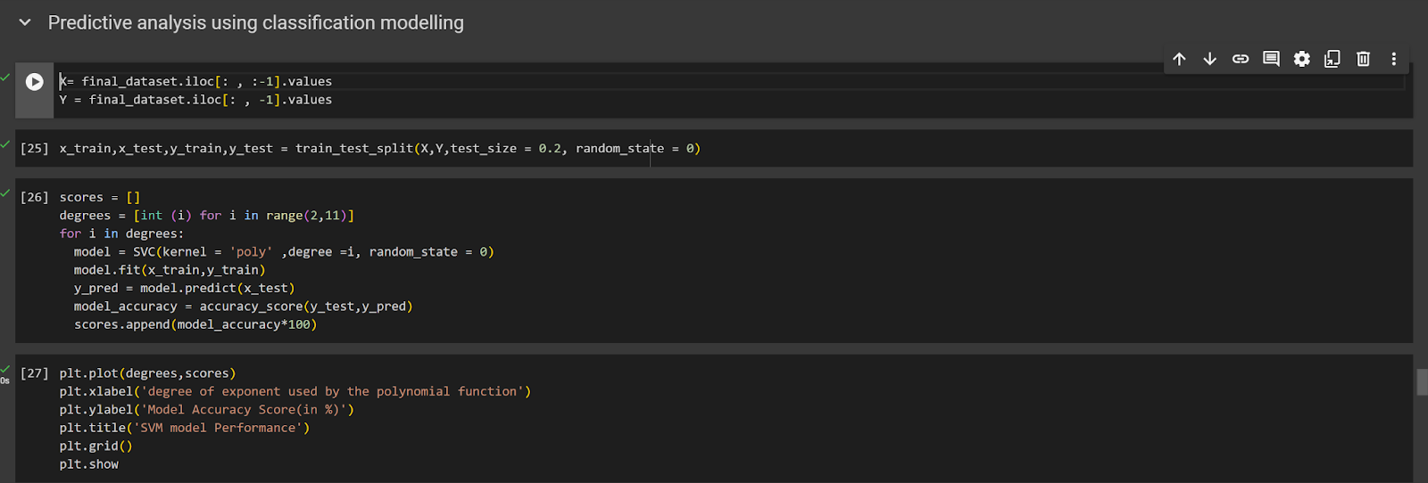
Technical Coding Demo

Slide 15


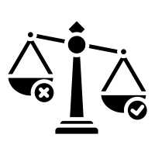


Ethical Concerns
Consumer Privacy
Fairness and Bias
Transparency and Accountability
Informed Consent
Access and Equity

Slide 16
What’s Next?
“For the first time human eyes won’t be the only ones pondering and exploring our world”
― Fei Fei Li
TedTalk: How we teach computers to understand pictures

Slide 17

Advancements
Enhanced Consumer Engagement
Predictive Analytics
Automation and Efficiency

Slide 18
Advancement
Insights from natural language bots
Sentiment Analysis
Content creation using AI tools
Enhanced product recommendations

Slide 19

Challenges
Talent Shortage
Ethical Considerations
Integration Complexity

Slide 20

Areas for Further Research
Algorithm Development
Interdisciplinary Collaboration
Long-Term Impact Assessment

Slide 21
References
Feifei Li (2015). TED Talk: How we teach computers to understand pictures https://youtu.be/40riCqvRoMs
Andrew Ng (2022). TED Talk: How AI enpower any business. https://www.ted.com/talks/andrew_ng_how_ai_could_empower_any_business?language=en
Wassouf, Wissam Nazeer ; Alkhatib, Ramez ; Salloum, Kamal ; Balloul, Shadi Cham: Springer International Publishing Journal of big data, 2020-04, Vol.7 (1), p.1-24, Article 29
Davenport, T., Guha, A., Grewal, D. et al. How artificial intelligence will change the future of marketing. J. of the Acad. Mark. Sci. 48, 24–42 (2020). https://doi.org/10.1007/s11747-019-00696-0
IBM (2023). AI in marketing: How to leverage this powerful new technology for your next campaign https://www.ibm.com/blog/ai-in-marketing/

